Slide 1
One object, many representations
DAY 05 OF 16 · 3D & 6DOF STREAMING
Points, meshes, voxels and depth maps: what each one is good at, and how to convert between them.
Point clouds
Meshes
Voxels
Depth maps
Conversions
Trade-offs
Book: Ch. 4 · Code: day05_representations/
Notes:
This session follows Chapter 4 of the book, 3D Data Representations, and its ‘canonical link’ section on converting between them. The streaming relevance: the representation you choose decides what you send and how the client renders it.

Slide 2
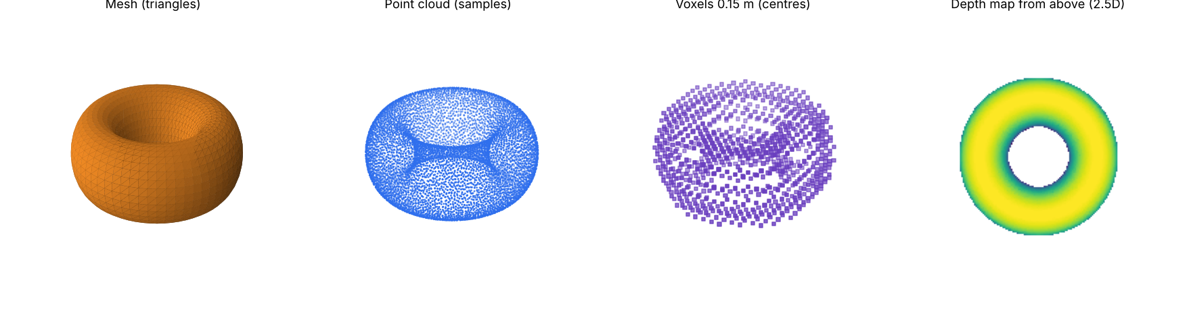
The same torus in four representations
LAB PREVIEW
From representations.py. Each is a different answer to: how do I store a surface?
Day 05 · Representations
2
Notes:
Generated by today’s script. Go left to right: a mesh of triangles, a point sample of its surface, voxels of 15 cm, and a top-down depth map. Ask students which one could tell you the torus has a hole through it. The mesh, because its connectivity (topology) encodes it; the point cloud only implies it. 3 minutes.

Slide 3
Point clouds vs meshes
BOOK CH. 4
Point cloud
Mesh
Free points. Exact samples, fast to transform and render, but no surface between points and high memory.
Vertices joined by edges into faces (usually triangles). A continuous surface with topology. The standard in games and film.
01
02
Day 05 · Representations
3
Notes:
Use the book’s tables. For point clouds (Table 4-1): fast rendering, exact representation, fast transformations; disadvantages: numerous points and high memory consumption. A mesh is a boundary representation (B-rep): faces, edges and vertices are its topological elements. Triangle meshes dominate because GPUs draw triangles natively. Mention that point rendering keeps improving; the book notes Unreal Engine 5 supports it well. For streaming: meshes need fewer primitives for smooth surfaces, points are easier to cut into pieces and to refine progressively.

Slide 4
Voxels and depth maps
BOOK CH. 4
Voxels
Depth map / RGB-D
3D pixels on a grid, like Lego or Minecraft. Store volume, so they suit simulation. Size grows fast as the grid gets finer.
An image with one distance per pixel. Small and image-friendly, but 2.5D: one value per line of sight.
01
02
Day 05 · Representations
4
Notes:
The book calls voxels the 3D analogue of 2D pixels and notes they can store true matter volume, which is useful for physics and simulation. The cost: halving the voxel size multiplies the count by up to 8 for volumes, about 4 for surfaces. The lab prints 260, 895 and 5,958 voxels for sizes 0.30, 0.15 and 0.05 m. Depth maps: low memory, well-known raster format, but a 2.5D representation that cannot describe a whole scene alone (book Table 4-4). Hint for later: V-PCC compression on Day 13 turns point clouds into depth maps on purpose so that video codecs can compress them.

Slide 5

Converting between representations
THE CANONICAL LINK
01
02
03
04
05
Mesh → points
Points → voxels
Voxels → points
Points → depth
Points → mesh
Sample the surface (uniform or Poisson-disk).
Snap each point to a grid cell; keep occupied cells.
Take each voxel centre: detail below the cell size is lost.
Project with a camera; keep the nearest per pixel.
Surface reconstruction, e.g. Poisson (Day 10).
Every arrow loses or invents information. Lab L3 measures how much.
Day 05 · Representations
5
Notes:
The book’s section ‘3D Data Canonical Link’ shows mesh to point cloud, voxel to point cloud and raster to point cloud. Explain that every arrow loses or invents information: sampling loses connectivity, voxelisation loses detail below the cell size, depth projection loses everything hidden, and meshing invents a surface between samples. A key exercise in Lab L3 measures that loss with the Chamfer distance.

Slide 6
Which representation for which job?
CHOOSING
Need | Best fit | Why
Raw capture, measurement | Point cloud | Closest to the sensor, exact samples
Real-time rendering, games, AR | Mesh | GPUs draw triangles; compact for smooth surfaces
Simulation, occupancy, robotics | Voxels | Volume and free space are explicit
Per-frame sensing, video codecs | Depth / RGB-D | Image tools and hardware codecs apply
Photo-real novel views | Gaussian splats (Day 10) | Soft primitives, view-dependent colour
Day 05 · Representations
6
Notes:
Discuss the table and invite disagreement: there is no single best representation. A production 6DoF system often uses several: points for capture, meshes or splats for display, voxels or octrees for organising the stream.

Slide 7
Convert a torus four ways
HANDS-ON LAB · COPY, RUN, LOOK
RUN IT
cd day05_representations
python representations.py
→ Read the size line for each representation.
→ Rotate the window: points, mesh and voxels side by side.
→ Try voxel sizes 0.5 and 0.02.
Day 05 · Representations
7
Notes:
Run, compare printed sizes, then the README exercises: swap the torus for a box or sphere, sweep the voxel size and plot count against size on log-log axes (slope near −2 for a surface), and render the depth map from the side. 30 minutes.

Slide 8
Three things to remember
1
Points = samples, mesh = connected surface, voxels = volume grid, depth map = 2.5D image.
2
Converting between them always loses or invents information.
3
Streaming systems pick the representation that is cheapest to send and to draw.
BEFORE NEXT SESSION
Lab L3 questions 1. Next: where does 3D data come from? Bring a phone.
Day 05 · Representations
8
Notes:
Recap and preview Day 6 on capture: the pinhole camera, RGB-D sensors and how depth turns into a point cloud. Ask students to bring a phone; if anyone has a LiDAR-equipped phone, even better for mini-project P1.

